Slide 1
BMEG3105-Introduction to Pandas and NumPy
Qinze YU
Wednesday, September 21, 2022
qzyu22@cse.cuhk.edu.hk
Department of Computer Science and Engineering (CSE)
The Chinese University of Hong Kong (CUHK)

Slide 2
Pandas

Slide 3
Pandas
Pandas: A data analysis and manipulation tool, built on top of the Python.

Slide 4
Types of data structure in Pandas
Data Structure | Dimensions | Description
Series | 1 | 1D labeled homogeneous array, size-immutable
DataFrame | 2 | General 2D labeled, size mutable tabular structure
Panel | 3 | General 3D labeled, size mutable array

Slide 5
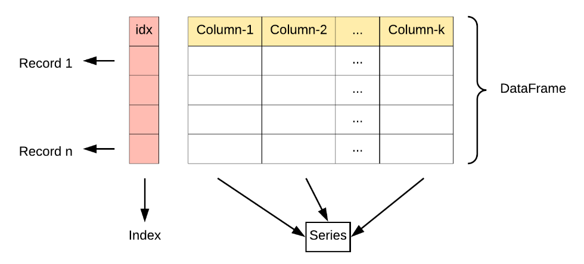
DataFrame

Slide 6
DataFrame
Series2
Series3
Name | Age | Gender
Tom | 22 | Male
Lily | 19 | Female
Jim | 39 | Male
Sherry | 27 | Female
Series1

Slide 7
DataFrame
Column | Type
Name | String
Age | Integer
Gender | String

Slide 8
NumPy

Slide 9
What is Numpy?
NumPy is the fundamental package for scientific computing in Python.
NumPy provides multidimensional array object

Slide 10
What is Numpy?
Numpy, Scipy, and Matplotlib provide MATLAB-like functionality in python.
Numpy Features:
Typed multidimentional arrays (matrices)
Fast numerical computations (matrix math)
High-level math functions

Slide 11
Why do we need NumPy?
Python does numerical computations slowly.
1000 x 1000 matrix multiply
Python triple loop takes > 10 min.
Numpy takes ~0.03 seconds

Slide 12
Array
Structured lists of numbers.
Vectors
Matrices
Images
Tensors

Slide 13
Distance and Similarity
Distance estimates the similarity between objects
Distance low Similarity high
Distance high Similarity low

Slide 14
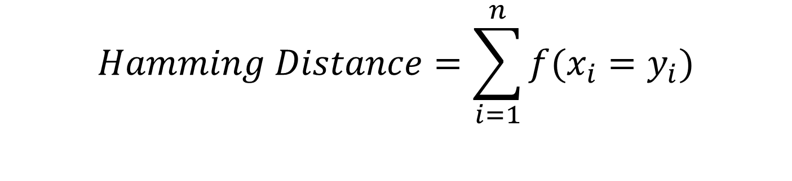
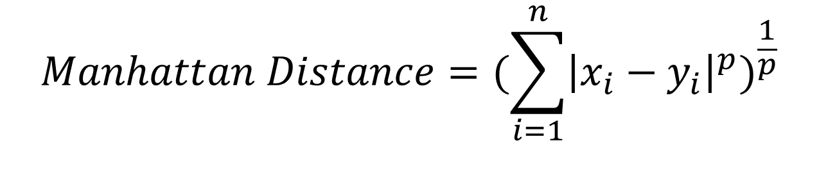
Common ways to calculate distance
Manhattan Distance
Hamming Distance
……
.......
$$Manhattan Distance={(\sum_{i=1}^{n}{{\left|x_{i}−y_{i}\right|}^{p}})}^{\frac{1}{p}}$$
$$Hamming Distance=\sum_{i=1}^{n}{f(x_{i}=y_{i})}$$

Slide 15
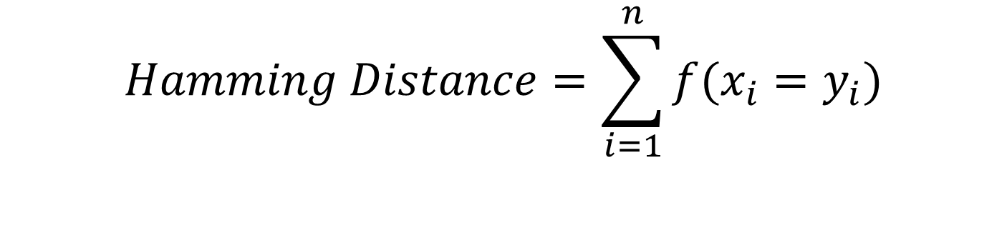
Example
$$Hamming Distance=\sum_{i=1}^{n}{f(x_{i}=y_{i})}$$
GCGAACGTAA
GCGTAGGTAA
Hamming Distance?
Similarity?

Slide 16
Thanks!

